Slide 1

H-Shaped Patch Antenna for Wi-Fi/WiMAX
BY
1602-23-735-175 s Saiteja
1602-23-735-176 A Sashank
1602-23-735-182 m srinivas

Slide 2
Abstract
Using Ansys HFSS, you can design an H-shaped patch antenna for Wi-Fi and WiMAX. The process involves modeling the antenna's geometry and using simulation to optimize its dimensions. The H-shape is key, as it helps to increase the antenna's bandwidth and gain. You'll analyze the simulation results, focusing on key metrics like return loss (S11​), to ensure the design is efficient and meets the performance requirements for your target application.

Slide 3
Introduction
The H-shaped patch antenna is a variant of the standard microstrip patch antenna, distinguished by its unique H-shaped radiating element.
This specific geometry is engineered to enhance the antenna's performance, providing a larger bandwidth and higher gain compared to a simple rectangular design.
It is particularly well-suited for wireless communication systems that require multi-band operation, such as Wi-Fi and WiMAX, which utilize frequency bands around 2.4 GHz and 5.8 GHz.
Like other patch antennas, its compact size, low-profile, and simple fabrication make it an excellent choice for integration into modern electronic devices.

Slide 4

Ansys (Analysis System)
Ansys HFSS is a powerful 3D electromagnetic simulation software used by engineers to design and analyze high-frequency electronic components. It specializes in predicting the behavior of things like antennas, RF components, and high-speed circuits. Using the Finite Element Method (FEM), HFSS provides highly accurate simulations, allowing designers to optimize performance and identify potential issues virtually, long before any physical prototyping begins.

Slide 5
Antenna Design Structure
Shape: Rectangular patch with two rectangular slots forming “H” shape.
Substrate: FR4 Epoxy (εr = 4.4, h = 1.6 mm).
Feeding Technique: Microstrip line feed or coaxial probe feed.
Dimensions Example:
Patch length (L) ≈ 29 mm
Patch width (W) ≈ 38 mm
Slot length ≈ 8 mm
Slot width ≈ 2 mm

Slide 6
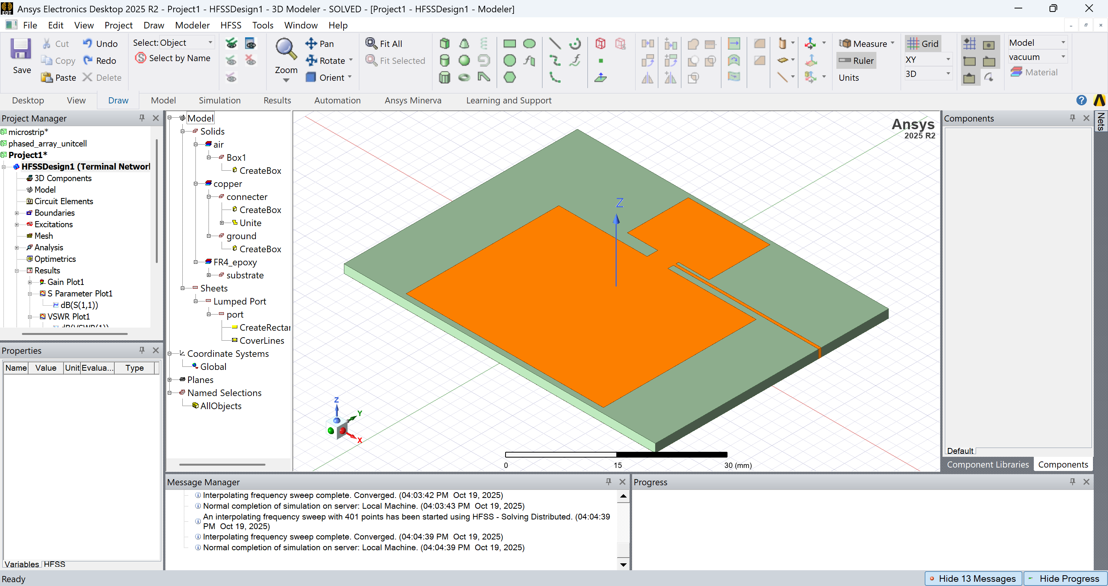

Slide 7
Working Principle
When the antenna is fed with RF power:
Surface current flows along the patch edges.
The slots increase current path, creating additional resonance modes.
These modes combine to yield wider bandwidth and better impedance matching.
Dual-frequency or multiband operation can be achieved by tuning slot dimensions.

Slide 8
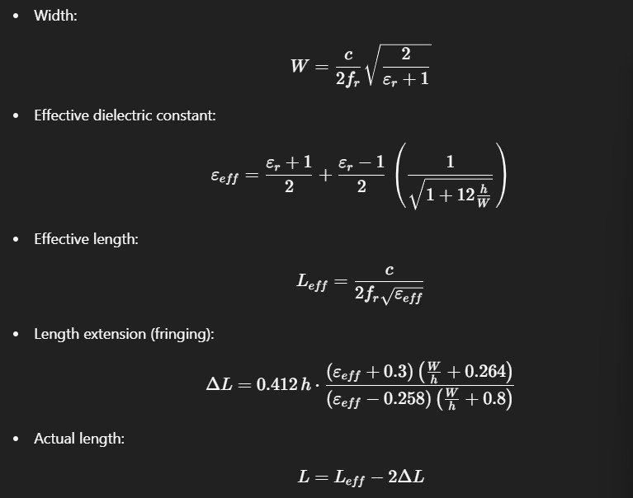
Design Equations

Slide 9
Calculations for H-Shaped Patch Antenna for Wi-Fi/WiMAX
Calculated Values
Patch Width (W1 and W2): ≈ 38 mm and 15.5 mm
Effective dielectric constant (ϵreff​): ≈ 4.09
Effective length (Leff​): ≈ 29.4 mm and 11.75 mm
Length extension (ΔL): ≈ 0.7 mm
Actual length (L): ≈ 28 mm and 11 mm

Slide 10
Simulation Results (Typical)
Resonant Frequency: 2.4 GHz
Return Loss (S11): −25 dB
VSWR: 1.1
Gain: 6.8 dBi
Bandwidth: ~150 MHz (Improved compared to conventional patch)
Radiation Pattern: Nearly omnidirectional

Slide 11
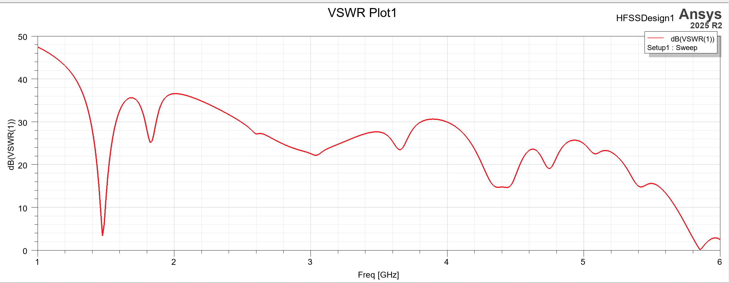
VSWR Plot (Voltage Standing Wave Ratio)

Slide 12
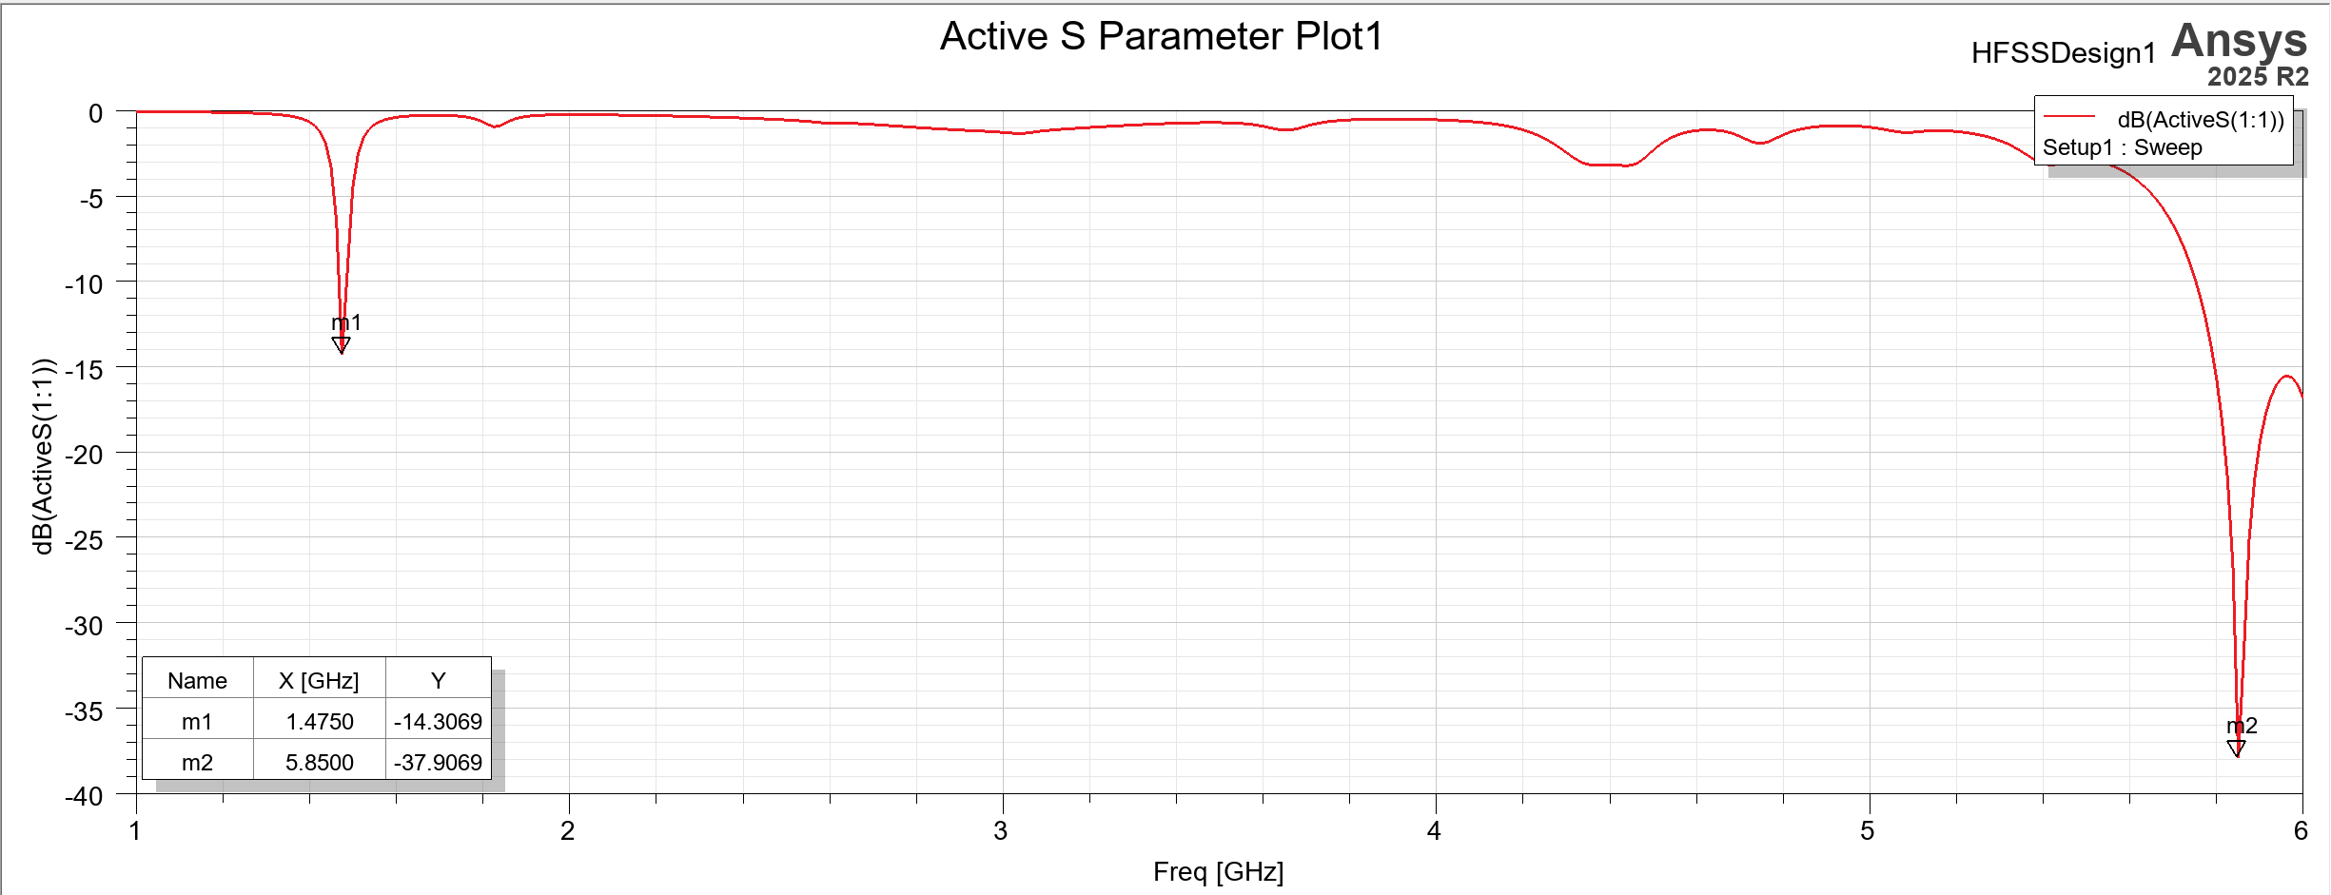
S Parameter Plot

Slide 13
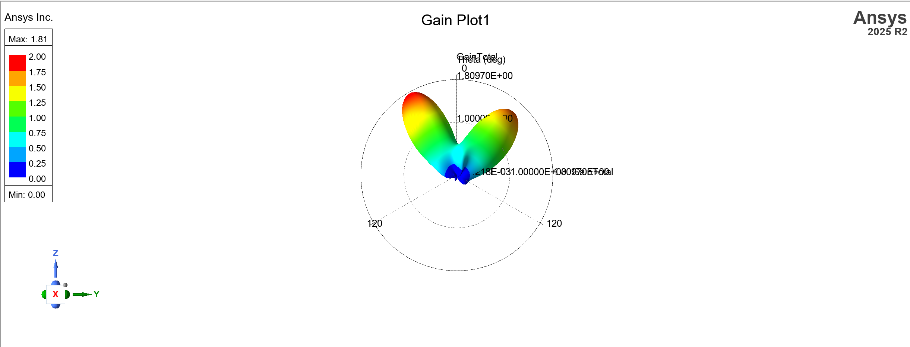
Gain 3-d Plot

Slide 14
Advantages
Compact and light weight
Simple design, easy fabrication
Enhanced bandwidth and gain
Supports dual/multiband operation
Suitable for modern wireless communication

Slide 15
Applications
Wi-Fi and WLAN (2.4 GHz, 5 GHz)
Bluetooth devices
GPS systems
IoT communication modules
Radar and satellite systems
Mobile and wireless sensor networks

Slide 16
Conclusion
The H-shaped microstrip patch antenna offers high performance in a compact design.
By adjusting slot dimensions, the antenna can be optimized for bandwidth, gain, and dual-band operation.
It is an excellent choice for next-generation wireless and satellite communication systems.

Slide 17
Thank You

